Slide 1


welcomes

Slide 2
Introduction of

Slide 3
Today’s Agenda
Introduction of Group
JavaScript MVC
TODO App using Backbone
Introduction to Famo.us
Manage your code using GIT

Slide 4
Java Script MVC

Slide 5
Presentation For
Developers
UI Developer
UI Designer
Web Developer
Web Designer
Any one knows Java Script

Slide 6

MVC
Hey!!! I am UI Developer, so… can you please start with what is MVC?

Slide 7
What is MVC?
Model–View–Controller (MVC) is a software architectural pattern
Two principal separations
Presentation from the model
Controller from the view
Separation of presentation and model is the most important design principle.
Controller
View
Model
Notes:
Purpose of MVC is separate out each layer so application become easily scalable
For example you want to change look of your application only view gets impacted if all 3 layers are properly seperated

Slide 8
I am working on Front End Development (HTML5, CSS3 and Java Script). Where and why do I need MVC?

Slide 9
Web evolution
Moved from desktop application to Web application
Classic Multi page Web
Poor User experience, after each action user has to wait for page to load.
JavaScript used only for
Form Validation
Handling DOM events
Web Applications are good, but not as productive as Desktop applications.

Slide 10
Single Page Application
From 2005 , AJAX has introduced
Only required data traverse on network
Why do we need to reload page?
JavaScript is playing Key Role
Sending Data to Server
Parsing Response from Server
Rendering Data using creating and Manipulating DOM Elements

Slide 11

I know jQuery and I can do everything using jQuery than what’s need of MVC ???

Slide 12
Need of MVC
jQuery is Library
jQuery is more focused on DOM
SPAs has lots of JavaScript code
No guidance on organization or structure for code
Result is
Large function
Nested Call backs
Unmaintainable code
Tightly coupled so not easily scalable

Slide 13


Okay!!!, but everything is on front end what should be separated?

Slide 14
What should be separated
AJAX Requests
Data Manipulation
Rendering Data
DOM element creation & manipulation
Event Handling

Slide 15
How to separate them
Model
AJAX Requests
Data
View
Rendering Data
DOM manipulation and creation
Controller
User Action / Event Handling

Slide 16

Is there any simple way to achieve this?

Slide 17
Java Script MVC Frameworks
Framework make it easy to implement MVC pattern
Framework has all necessary things which makes each layer independent and scalable
Good News
Many JS MVC frameworks available
Framework can be used with libs for taking advantage of simplicity and interactivity with structured code.
Some of them can be used with jQuery ☺

Slide 18
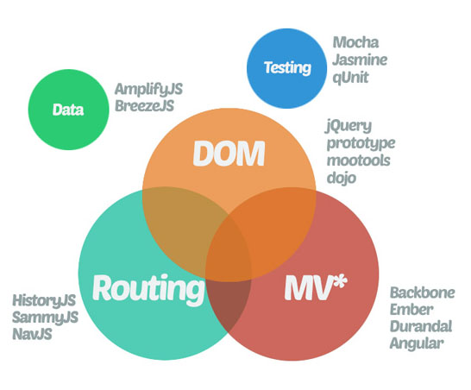

Slide 19


Looks like there is some mistake, You said MVC , but here it is MV* !!!

Slide 20
MV* Frameworks
Where is Controllers ?
More than one layer plays controller role
For Example
Views handling rendering of data
View handling events
Routes handling navigation
Remember, “Separation of presentation and model is the most important design principle”

Slide 21

Hey!!!, I am ready, Can you show me how to start?

Slide 22
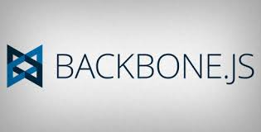
Sample MV* Application
By Dinesh, Chintan & Parth

Slide 23
What Is Backbone?
Light Weight MV* Framework (Separate UI logic from Business Logic)
Creating Single Page Applications
Communication to the server only through a RESTful API.
Make Your Code Modular.
Incredible Small Library.
Structure Your Application (JQuery lacks here)

Slide 24
Dependencies & useful Libraries
Underscore.js : Sole and Hard dependency
Jquery.js : handling DOM Operations easily
Marionette JS : Taking backbone one step ahead
Jasmine/Coffee/Mocha/Chai : Testing Your JS logic

Slide 25
Demo of TODO Application

Slide 26
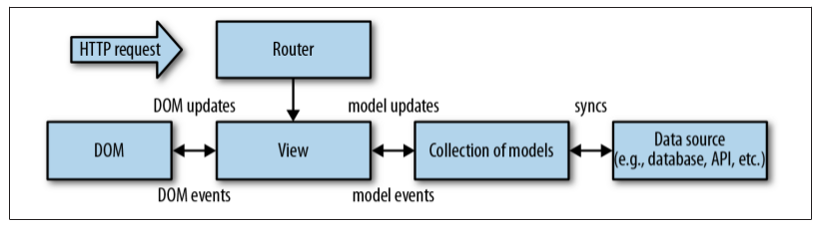
What Backbone consists of?
Router
Model
Collection
View
Template
History
Template
History

Slide 27
Routers
Routing Your Application URL’s When Using Hash Tags
Dynamic Routing (based on the Parameter after # )

Slide 28
Routers In Current Application
On Page Load (#todos/index)
Creating a new note (#todo/new)

Slide 29
Model And Collection
Model
Contains Data
Validate Data
Implements Business Logic
Collection
Set Of Models
Provides Options of Processing Data stored in Models.

Slide 30
Models And Collection in Current Application
Model
App.todoModel
Contains the Data for a single To-do
Defaults
Validation
Collections
App.todoCollection
Collection of All To-do (App.todoModel)

Slide 31
Views
Rendering Data in to HTML Code
Acts As A Bridge Between Business Logic And A User.
Handle Events on the Template Bound to it.
Views can Render Model And Collections
Backbone View Relies On JQuery for easy DOM Manipulations.

Slide 32
Views in Current Application
App.todoIndexView
Displaying the Collection of To-dos
App.todoRowView
For Displaying single To-do Activity in a Row.
App.todoNewView
New To-do Creation

Slide 33
Template
Separate HTML Markup
More Structured And Clean Application
Templating Logic Provided by: Underscore.js, Handlebars and more libraries

Slide 34
Template In Current Application
indexTemplate
My Main Page Where in My all To-do’s and option of creating a new To-do are shown.
rowTemplate
shows my singleTo-do.
FormTemplate
Rendered When Creating A New To-Do.

Slide 35
Where NOW From HERE?
Advanced Backbone Features
Using Backbone plugins, Inheritance, Best Practices, Marionette and more.
From Simple to do list to Complex Applications
Walmart Mobile App.
USA Today.
LinkedIn Mobile App.

Slide 36
Query & Questions

Slide 37
THANK YOU

